Slide 1






React Fundamentals
Module 02

Slide 2
Review
MERN Introduction
PSEB IAB Program
What is Web?
History of WEB 1.0 to 3.0
Overview of Full-stack web development
Overview of the course
ES6
Lab – Hands-on practice

Slide 3
Outline
React Fundamentals
React Basics
React Render
React JSX
React Components
React Props
React Events
React Conditional Rendering
React Lists
Styling React Using CSS
React Advanced
React hooks
useState
useEffect
useContext
React Forms
React Router
React Bootstrap
Practice

Slide 4
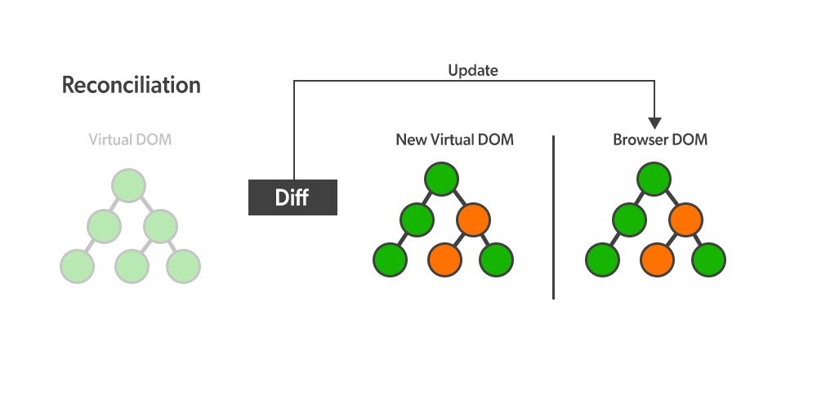
React Introduction
React Basics
What is React?
Static vs Dynamic HTML
React, sometimes referred to as a frontend JavaScript framework, is a JavaScript library created by Facebook.
React is a tool for building UI components.
How does React Work?
React creates a VIRTUAL DOM in memory.
React only changes what needs to be changed!
React.JS History
Current version of React.JS is V18.0.0 (April 2022).
Initial Release to the Public (V0.3.0) was in July 2013.

Slide 5
React Getting Started
React Basics
01-React Directly in HTML
02-Setting up a React Environment
If you have npx and Node.js installed, you can create a React application by using create-react-app.
npx create-react-app my-react-app
Run the React Application
Run this command to run the React application my-react-app:
npm start
React ES6

Slide 6
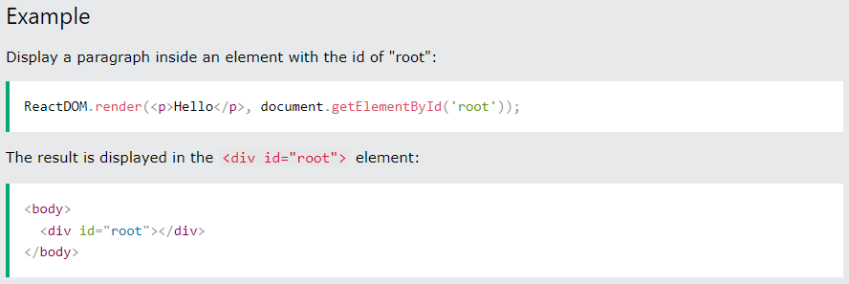
React Render HTML
React Basics
The Render Function
React renders HTML to the web page by using a function called ReactDOM.render().
The ReactDOM.render() function takes two arguments, HTML code and an HTML element.

Slide 7
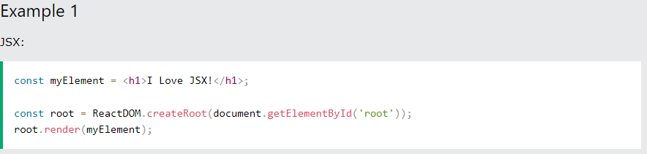
React JSX
React Basics
What is JSX?
JSX stands for JavaScript XML.
JSX allows us to write HTML elements in JavaScript and place them in the DOM without any createElement() and/or appendChild() methods.
JSX follows XML rules, and therefore HTML elements must be properly closed.

Slide 8
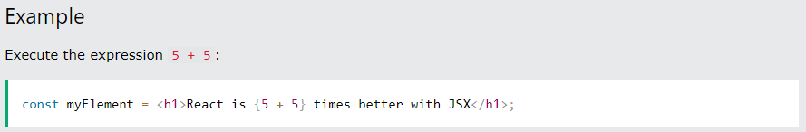
React JSX
React Basics
Expressions in JSX
With JSX you can write expressions inside curly braces { }.
The expression can be a React variable, or property, or any other valid JavaScript expression. JSX will execute the expression and return the result:

Slide 9
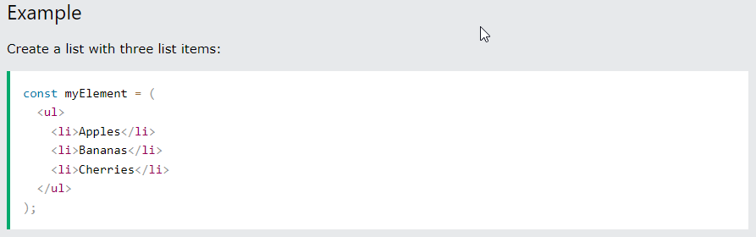
React JSX
React Basics
Inserting a Large Block of HTML in JSX
To write HTML on multiple lines, put the HTML inside parentheses ():

Slide 10
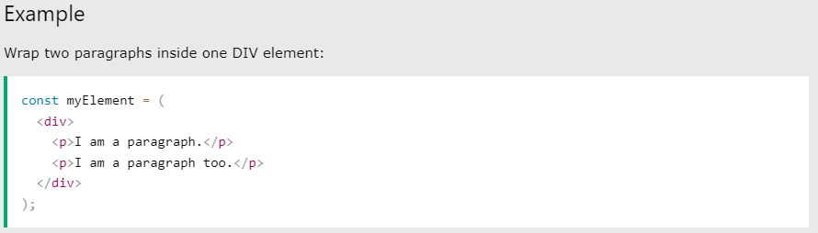
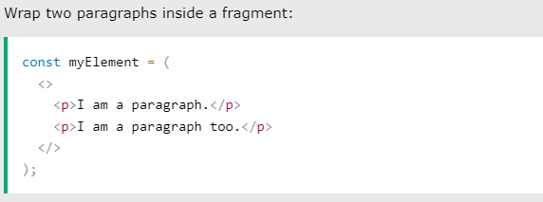
React JSX
React Basics
Inserting a Large Block of HTML in JSX
To write HTML on multiple lines, put the HTML inside parentheses ():
One Top-Level Element
The HTML code must be wrapped in ONE top-level element or fragment <></>.

Slide 11
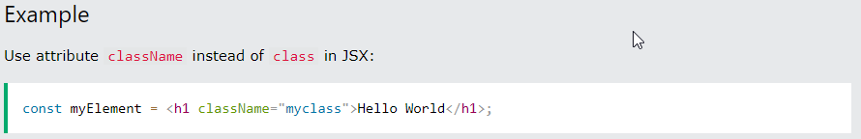
React JSX
React Basics
Inserting a Large Block of HTML in JSX
To write HTML on multiple lines, put the HTML inside parentheses ():
One Top-Level Element
The HTML code must be wrapped in ONE top-level element or fragment <></>.
Attribute class = className

Slide 12
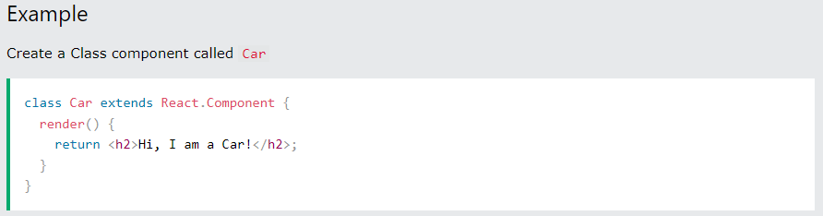
React Components
React Basics
What are React Components?
Components are like functions that return HTML elements.
Class components and Function components
Create Your First Component
The component's name MUST start with an upper case letter.
Class Component

Slide 13
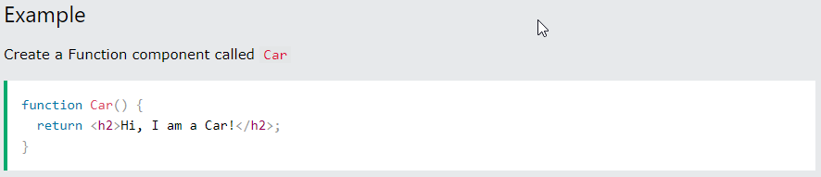
React Components
React Basics
What are React Components?
Components are like functions that return HTML elements.
Class components and Function components
Create Your First Component
The component's name MUST start with an upper case letter.
Class Component
Function Component

Slide 14
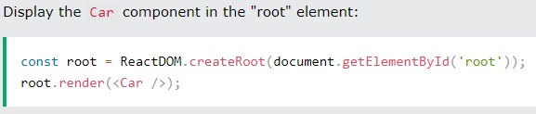
React Components
React Basics
What are React Components?
Components are like functions that return HTML elements.
Class components and Function components
Create Your First Component
Function Component
Rendering a Component

Slide 15
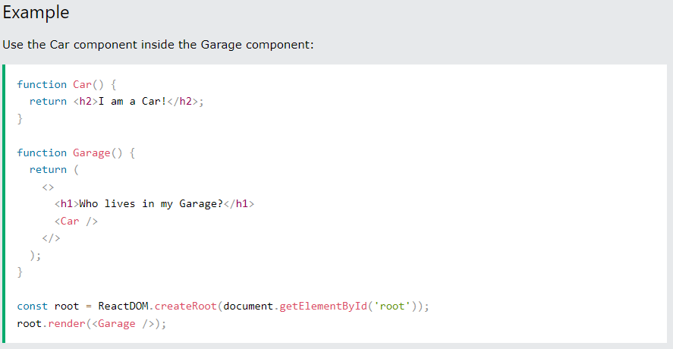
React Components
React Basics
Components in Components
We can refer to components inside other components:

Slide 16
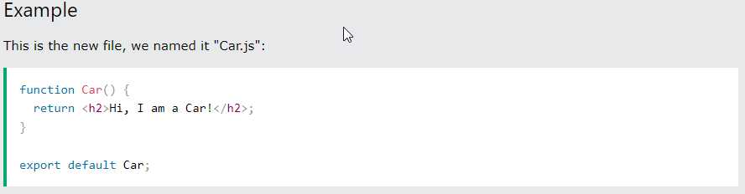
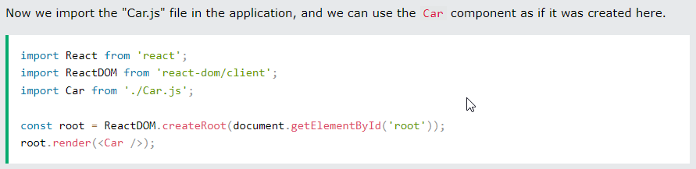
React Components
React Basics
Components in Files
React is all about re-using code, and it is recommended to split your components into separate files.
To do that, create a new file with a .js file extension and put the code inside it:
Note that the filename must start with an uppercase character.

Slide 17
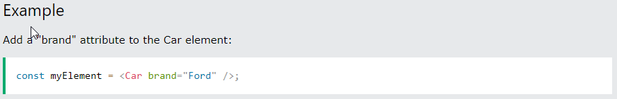
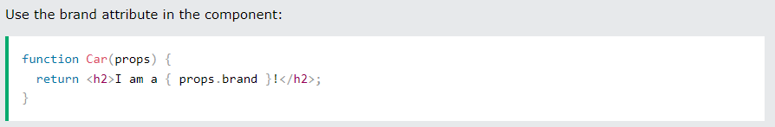
React Props
React Basics
What are React Props?
props stand for properties
React Props are like function arguments in JavaScript and attributes in HTML.
To send props into a component, use the same syntax as HTML attributes:
- The component receives the argument as a props object:

Slide 18
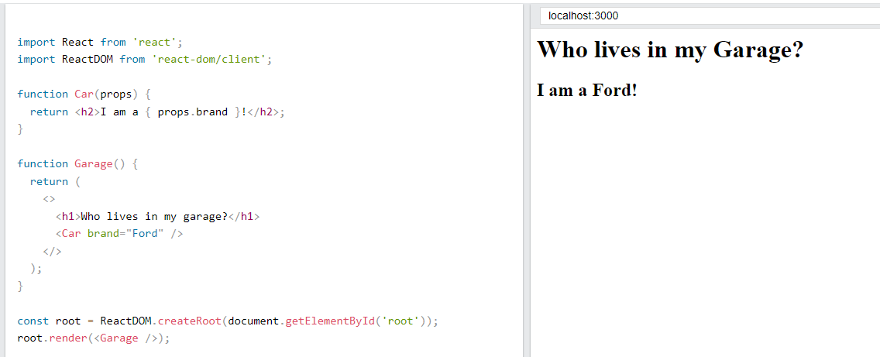

React Props
React Basics
Pass Data using React Props
React Props are like function arguments in JavaScript and attributes in HTML.
Props are also how you pass data from one component to another, as parameters.

Slide 19
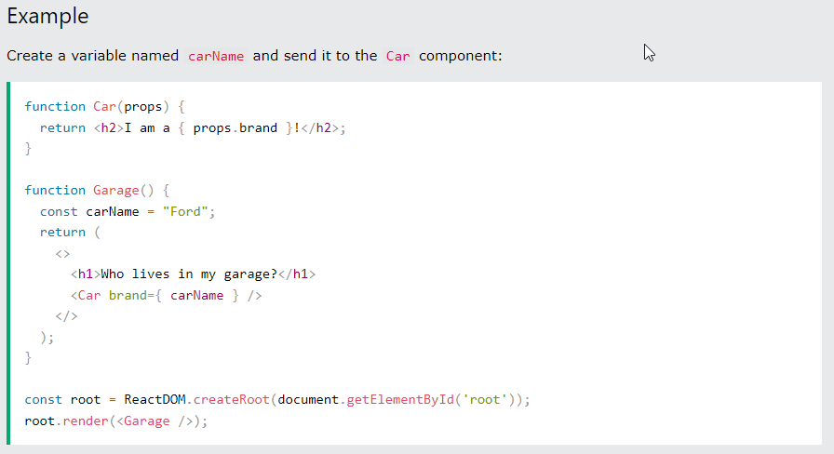
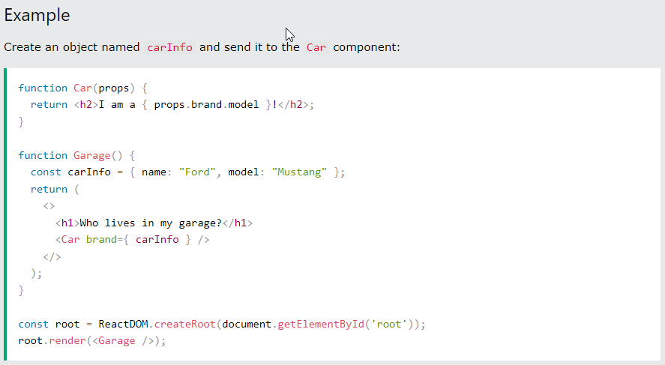
React Props
React Basics
Pass Data using React Props
If you have a variable/object to send and not a string, just put the variable/object name inside curly brackets {}:
Note: React Props are read-only! You will get an error if you try to change their value.

Slide 20
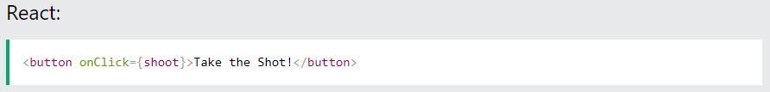
React Events
React Basics
What are React Events?
Just like HTML DOM events, React can perform actions based on user events.
React has the same events as HTML: click, change, mouseover etc.
Adding Events
React events are written in camelCase syntax:
onClick instead of onclick
React event handlers are written inside curly braces{}:
onClick={shoot} instead of onClick="shoot()"
Tryit Editor

Slide 21
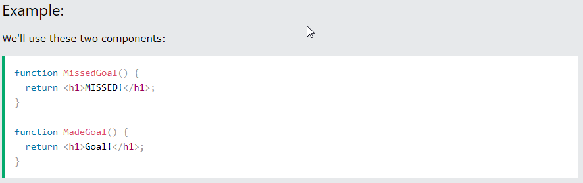
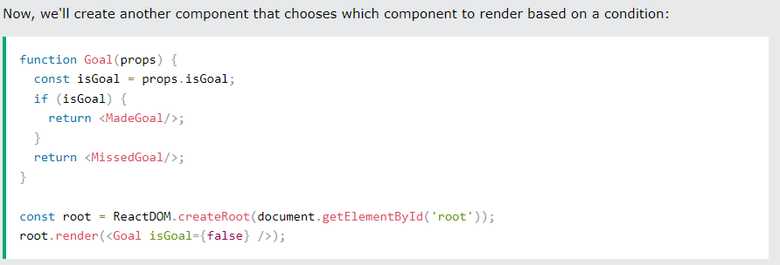
React Conditional Rendering
React Basics
In React, you can conditionally render components.
if Statement

Slide 22
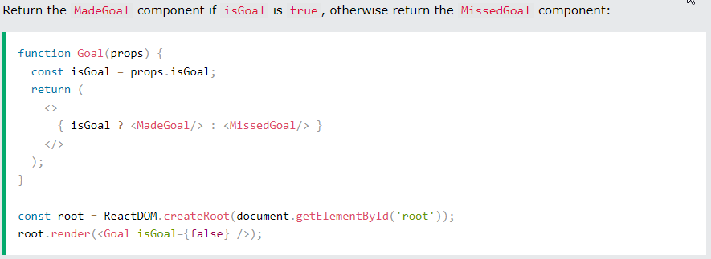
React Conditional Rendering
React Basics
In React, you can conditionally render components.
Ternary Operator
condition ? true : false

Slide 23
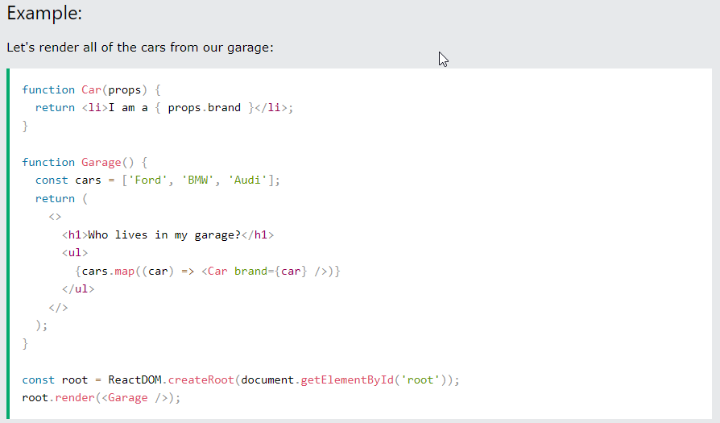
React Lists
React Basics
In React, you will render lists with some type of loop.
The JavaScript map() array method is generally the preferred method.

Slide 24
Styling React Using CSS
React Basics
There are many ways to style React with CSS, this tutorial will take a closer look at three common ways:
Inline styling
CSS stylesheets
CSS Modules
camelCased Property Names
Since the inline CSS is written in a JavaScript object, properties with hyphen separators, like background-color, must be written with camel case syntax:
Use backgroundColor instead of background-color

Slide 25
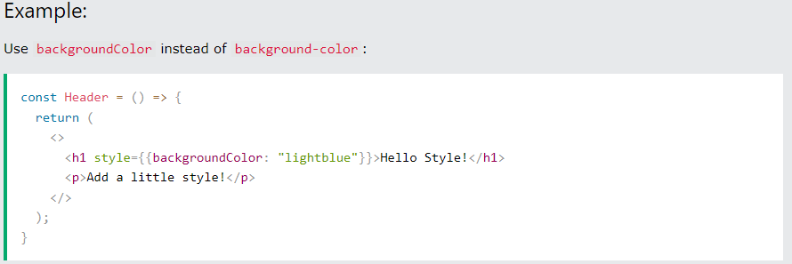
Styling React Using CSS
React Basics
Inline Styling
To style an element with the inline style attribute, the value must be a JavaScript object:
Note: In JSX, JavaScript expressions are written inside curly braces, and since JavaScript objects also use curly braces, the styling in the example above is written inside two sets of curly braces {{}}

Slide 26
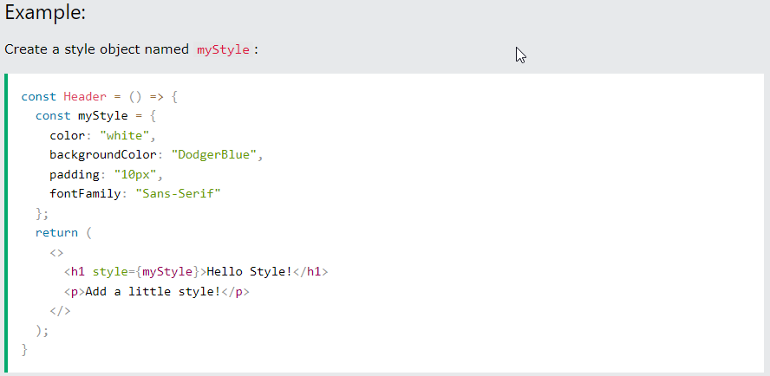
Styling React Using CSS
React Basics
Styling using JavaScript Object
You can also create an object with styling information, and refer to it in the style attribute:

Slide 27
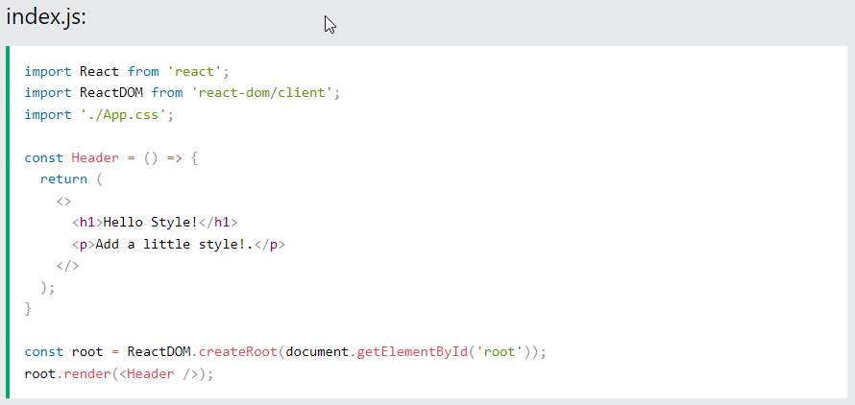
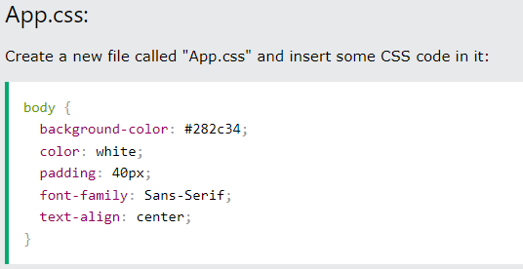
Styling React Using CSS
React Basics
CSS Stylesheet
You can write your CSS styling in a separate file, just save the file with the .css file extension and import it in your application.

Slide 28
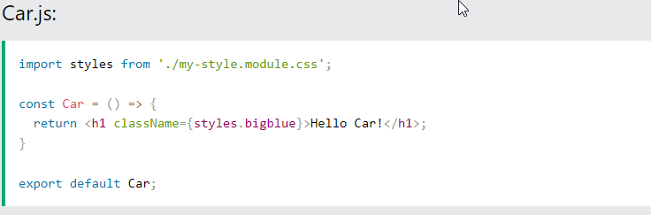
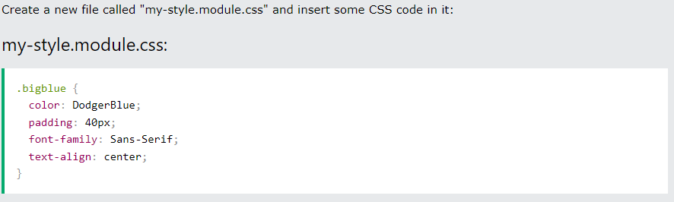
Styling React Using CSS
React Basics
CSS Modules
CSS Modules are convenient for components that are placed in separate files.
Create the CSS module with the .module.css extension, example: my-style.module.css.

Slide 29
React Advanced

Slide 30
React Hooks
React Advanced
What is a Hook?
Hooks allow us to "hook" into React features such as state and other React features without writing a class
Hook Rules
Hooks can only be called inside React function components.
Hooks can only be called at the top level of a component.
Hooks cannot be conditional
Hooks will not work in React class components.

Slide 31
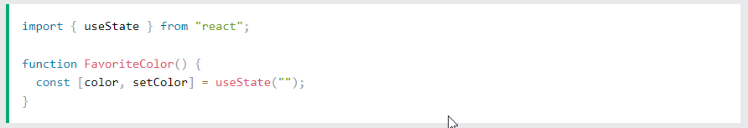
React useState Hook
React Advanced
What is useState hook?
The React useState Hook allows us to track state in a function component.
State generally refers to data or properties that need to be tracked in an application.
Initialize useState
We initialize our state by calling useState in our function component.
useState accepts an initial state and returns two values:
The current state.
A function that updates the state
What Can State Hold
The useState Hook can be used to keep track of strings, numbers, booleans, arrays, objects, and any combination of these!
We can create multiple state Hooks to track individual values
Tryit Editor
Tryit Editor
Tryit Editor

Slide 32
React useEffect Hooks
React Advanced
What is useEffect hook?
The useEffect Hook allows you to perform side effects in your components.
Some examples of side effects are: fetching data, directly updating the DOM, and timers.
useEffect runs on every render
useEffect accepts two arguments. The second argument is optional.
useEffect(<function>, <dependency>)
1. No dependency passed:
2. An empty array:
3. Props or state values:
useEffect(() => { //Runs on every render });
useEffect(() => { //Runs only on the first render }, []);
useEffect(() => { //Runs on the first render //And any time any dependency value changes }, [prop, state]);
Tryit Editor
Tryit Editor
Tryit Editor

Slide 33
React useContext Hook
React Advanced
What is React Context hook?
React Context is a way to manage state globally.
It can be used together with the useState Hook to share state between deeply nested components more easily than with useState alone.
Create Context
To create context, you must Import createContext and initialize it:
Context Provider
Wrap child components in the Context Provider and supply the state value.
Use the useContext Hook
In order to use the Context in a child component, we need to access it using the useContext Hook.
Tryit Editor Problem
Tryit Editor Solution

Slide 34
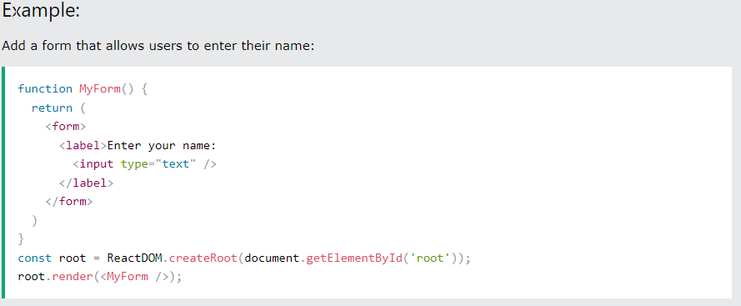
React Forms
React Advanced
Adding Forms in React
Just like in HTML, React uses forms to allow users to interact with the web page.

Slide 35
React Forms
React Advanced
Handling Forms
Handling forms is about how you handle the data when it changes the value or gets submitted.
In HTML, form data is usually handled by the DOM.
In React, form data is usually handled by the components.
When the data is handled by the components, all the data is stored in the component state.
We can use the useState Hook to keep track of each inputs value and provide a "single source of truth" for the entire application.
Tryit Editor useStae
Tryit Editor Multiple inputs

Slide 36
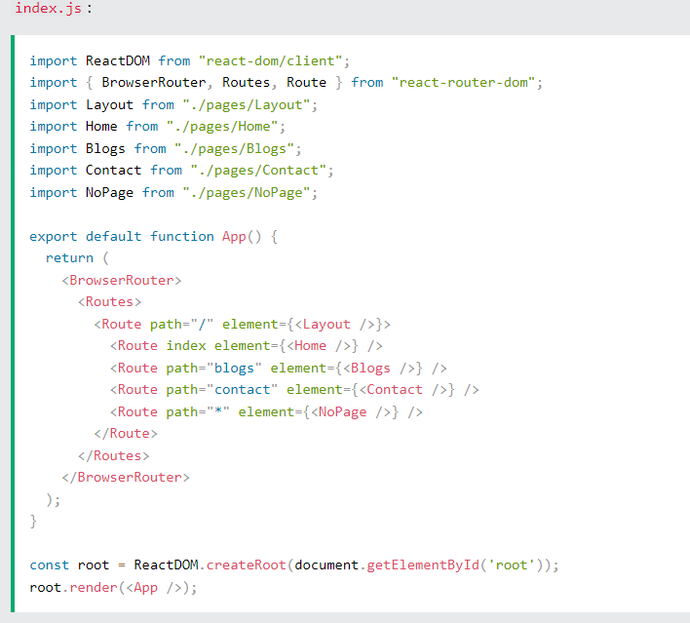
React Router
React Advanced
npm i -D react-router-dom
Folder Structure
Within the src folder, we'll create a folder named pages with several files:
src\pages\:
Layout.js
Home.js
Blogs.js
Contact.js
NoPage.js

Slide 37
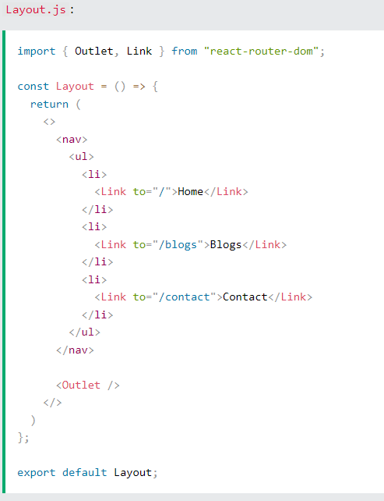
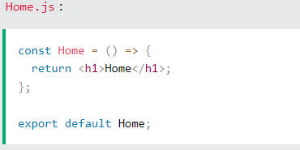
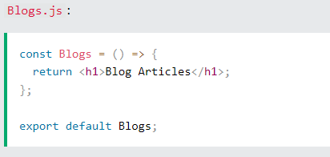
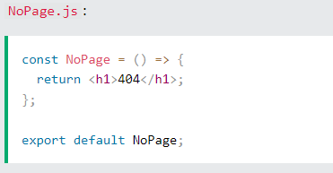
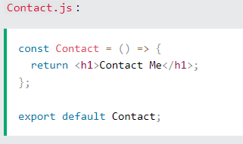
React Router
Pages / Components

Slide 38
Summary
React Fundamentals
React Basics
React Render
React JSX
React Components
React Props
React Events
React Conditional Rendering
React Lists
Styling React Using CSS
React Advanced
React hooks
useState
useEffect
useContext
React Forms
React Router

Slide 39
Hands-on Practice
Landing Page Tutorial

Slide 40
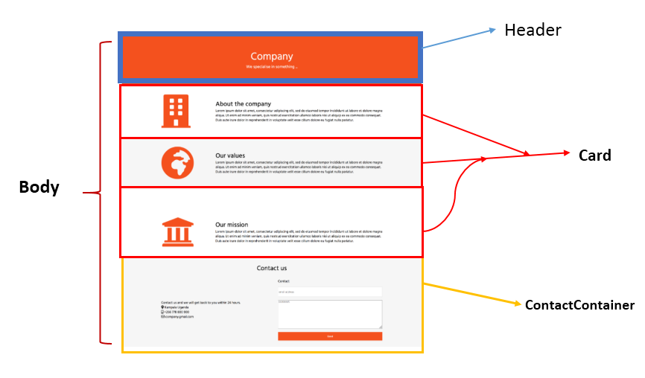
Notes:
A Responsive Landing Page with React | by Roland Sankara | Medium

